Slide 1
Concurrency
Semaphores
Deadlocks

Slide 2
Topics
Managing Critical Section
Mutex (discussed last week)
Semaphores
Deadlocks
Definition
Deadlocks with Mutex
Deadlocks With Semaphores
Practical Exercises

Slide 3
Semaphores

Slide 4
Semaphore P()
Semaphore: an integer combined with P and V operations
Call P to enter a critical section
(Proberen, or Passeren, or Pakken).
It is also known as wait operation
If semaphore value > 0, it can be decremented by one
Atomic decrement
If semaphore value == 0, calling P will cause the process to wait (blocks the process/thread)
Notes:
The canonical names V and P come from the initials of Dutch words. V is generally explained as verhogen ("increase"). Several explanations have been offered for P, including proberen ("to test" or "to try"),^{[3]} passeren ("pass"), and pakken ("grab"). Dijkstra's earliest paper on the subject^{[1]} gives passering ("passing") as the meaning for P, and vrijgave ("release") as the meaning for V. It also mentions that the terminology is taken from that used in railroad signals. Dijkstra subsequently wrote that he intended P to stand for the portmanteau prolaag,^{[4]} short for probeer te verlagen, literally "try to reduce", or to parallel the terms used in the other case, "try to decrease".^{[5][6][7]}

Slide 5
Semaphore V()
Semaphore: an integer combined with P and V operations
Call V to exit a critical section
(Verhogen, Vrijgave)
It is also known as signal operation
Increments the value of the semaphore by one
Allows the process that is waiting on V to continue
Notes:
The canonical names V and P come from the initials of Dutch words. V is generally explained as verhogen ("increase"). Several explanations have been offered for P, including proberen ("to test" or "to try"),^{[3]} passeren ("pass"), and pakken ("grab"). Dijkstra's earliest paper on the subject^{[1]} gives passering ("passing") as the meaning for P, and vrijgave ("release") as the meaning for V. It also mentions that the terminology is taken from that used in railroad signals. Dijkstra subsequently wrote that he intended P to stand for the portmanteau prolaag,^{[4]} short for probeer te verlagen, literally "try to reduce", or to parallel the terms used in the other case, "try to decrease".^{[5][6][7]}

Slide 6
Semaphore
Semaphore: an integer combined with P and V operations
For mutual exclusions problems, semaphore values are initialized to 1: called binary semaphore
Process P
// some code
// s is a semaphore
P(s);
// critical section
V(s);
// remainder section
Process Q
// some code
// s is a semaphore
P(s);
// critical section
V(s);
// remainder section

Slide 7
Example 1: Bridge
Remember Bridge problem from previous week?
Assume two or more observers are counting events using a shared record named Total.
Observers use semaphores to avoid race conditions
Global Semaphore S = 1
Process Observer
if Observed():
P(S);
temp = Read(Total)
temp = temp + 1
Store(temp , Total)
V(S);

Slide 8
Example 2: Travel Agency
A sales agent who is making a reservation for a flight should
Decrement the value of a semaphore ( P )
Read in the reservation list
Update the list
Increment the value of the semaphore ( V )
What happens if the sales agent forgets to complete the reservation (stays inside its critical section)? Discuss.
Notes:
Discussion: Other processes trying to enter their critical section will wait indefinitely. Although this implementation satisfies mutual exclusion, starvation problem is not satisfied. Therefore, it is better to read the reservation list before entering the critical section and update it inside the critical section (after making sure that it has not been changed, as we did last week with Mutex). The important point here is that the critical section should be as small as possible with no I/O or blocking operations.

Slide 9
Example 3: Printer Spool
To add an item to the print spool a process uses the following code:
Global Semaphore S initialized with 1
Data = Prepare()
P(S);
Spool[in] = Data
in = in + 1
V(s);

Slide 10
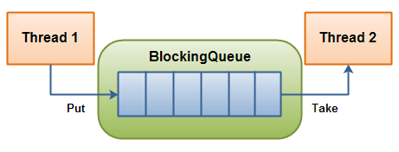
Producer-Consumer
Remember: Producers and Consumers sharing a buffer …
How can Producers and Consumers inform each other about the state of the buffer?
Consumer prefers to pick the item when it is ready, otherwise iteratively it has to check the buffer

Slide 11
Producer-Consumer: Example
Translating documents:
Translator threads need to be informed when a document is ready for translation
Doc.#x
Doc.#1
Doc.#y
Doc.#n-2
Doc.#n-1
Doc.#n
Doc.#2
Doc.#z
Doc.#3
Collecting from different sources, Reading
waiting to be processed
Language detection, Translations

Slide 12
Producer-Consumer
See how semaphores can help us …
Assume a shared buffer with only one empty space
Define two semaphores: ps and cs
Initialize ps=1 and cs=0

Slide 13
Producer-Consumer
Assume a shared buffer with only one empty space, we have two semaphores: ps and cs, Initializations are ps=1 and cs=0 ...
Process Producer
loop:
data = Produce()
P(ps)
buffer.Put( data )
V(cs)
Process Consumer
loop:
P(cs)
value = buffer.Take( )
V(ps)
Consume(value)

Slide 14
Producer-Consumer
Assume a shared buffer with only one empty space, we have two semaphores: ps and cs, Initializations are ps=1 and cs=0 ...
Process Producer
loop:
data = Produce()
P(ps)
buffer.Put( data )
V(cs)
Scenarios:
Start: buffer is empty,
if the consumer is faster, it has to wait in P(cs) . Why?
Process Consumer
loop:
P(cs)
value = buffer.Take( )
V(ps)
Consume(value)

Slide 15
Producer-Consumer
Assume a shared buffer with only one empty space, we have two semaphores: ps and cs, Initializations are ps=1 and cs=0 ...
Process Producer
loop:
data = Produce()
P(ps)
buffer.Put( data )
V(cs)
Scenarios:
buffer is empty,
if the consumer is faster, it has to wait in P(cs) . Why?
There will be a point where a producer will produce a data and ...
Process Consumer
loop:
P(cs)
value = buffer.Take( )
V(ps)
Consume(value)

Slide 16
Producer-Consumer
Assume a shared buffer with only one empty space, we have two semaphores: ps and cs, Initializations are ps=1 and cs=0 ...
Process Producer
loop:
data = Produce()
P(ps)
buffer.Put( data )
V(cs)
Scenarios:
buffer is empty,
if the consumer is faster, it has to wait in P(cs) . Why?
… it will be the first one to enter to the critical section. Why?
Process Consumer
loop:
P(cs)
value = buffer.Take( )
V(ps)
Consume(value)

Slide 17
Producer-Consumer
Assume a shared buffer with only one empty space, we have two semaphores: ps and cs, Initializations are ps=1 and cs=0 ...
Process Producer
loop:
data = Produce()
P(ps)
buffer.Put( data )
V(cs)
Scenarios:
buffer is empty,
if the consumer is faster, it has to wait in P(cs) . Why?
… when there is one producer in the critical section, other producers and all the consumers have to wait. Why?
Process Consumer
loop:
P(cs)
value = buffer.Take( )
V(ps)
Consume(value)

Slide 18
Producer-Consumer
Assume a shared buffer with only one empty space, we have two semaphores: ps and cs, Initializations are ps=1 and cs=0 ...
Process Producer
loop:
data = Produce()
P(ps)
buffer.Put( data )
V(cs)
… when there is one producer in the critical section, other producers and all the consumers have to wait. Why?
The producer finishes Put(). It executes V(cs). The waiting consumer will enter the critical section. Why?
Process Consumer
loop:
P(cs)
value = buffer.Take( )
V(ps)
Consume(value)

Slide 19
Producer-Consumer
Assume a shared buffer with only one empty space, we have two semaphores: ps and cs, Initializations are ps=1 and cs=0 ...
Process Producer
loop:
data = Produce()
P(ps)
buffer.Put( data )
V(cs)
… when there is one consumer in the critical section, other consumers and all the producers have to wait. Why?
The consumer finishes Take(). It executes V(ps). The waiting producer can enter the critical section. Why?
Process Consumer
loop:
P(cs)
value = buffer.Take( )
V(ps)
Consume(value)

Slide 20
Producer-Consumer
Assume a shared buffer with only one empty space, we have two semaphores: ps and cs, Initializations are ps=1 and cs=0 ...
Process Producer
loop:
data = Produce()
P(ps)
buffer.Put( data )
V(cs)
What if the buffer has more than one empty slot?
Check the exercises ...
Process Consumer
loop:
P(cs)
value = buffer.Take( )
V(ps)
Consume(value)

Slide 21

Time to Apply
Week 5: Exercise A (all of it).

Slide 22
Deadlocks

Slide 23
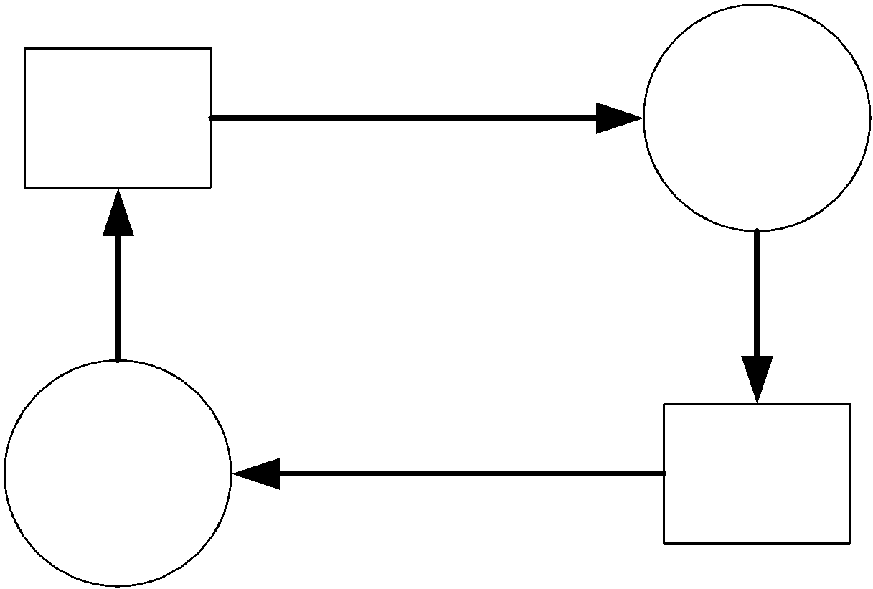
Deadlocks
When each process holds a resource needed by the other process, each process relies on the other process to make a progress.
This situation when no progress is made, is called a deadlock condition.
Notes:
Please note that the definition is valid for threads as well

Slide 24
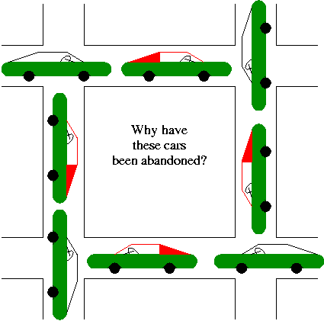
Example 1
What are resources here?
Who is waiting for what?

Slide 25
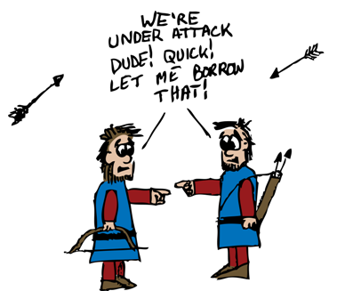
Example 2
What are resources here?
Who is waiting for what?

Slide 26
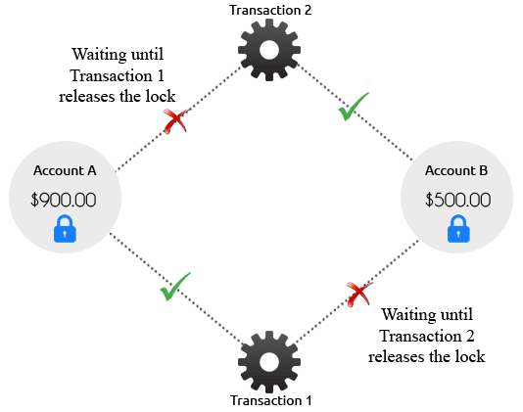
Example 3
What are resources here?
Who is waiting for what?

Slide 27
Conditions to Have a Deadlock
The four deadlock conditions are:
Exclusive resource access; no simultaneous sharing (only sequentially reusable).
Incremental allocation: processes do not request all resources together (hold and wait).
Circular waiting for resources.
No resource preemption.
These are necessary conditions; if any is missing, deadlock can’t occur.

Slide 28
Example 2 (Revised)
Each process holds a resource and is waiting for the next resource.
Before allocating resources, the manager should make sure that a circular waiting will not be created. How?

Slide 29

Discuss
How can we avoid deadlocks here?

Slide 30

Deadlock with Semaphores
A semaphore may be viewed as a resource counter.
For instance, a semaphore can be used to represent printers.
If we have two printers, the initial value of the semaphore will be 2.

Slide 31
Deadlock with Semaphores
Assume processes P and Q are going to use resources R1 and R2.
P requests the resources in R2, R1 order
Q requests the resources in R1, R2 order

Slide 32
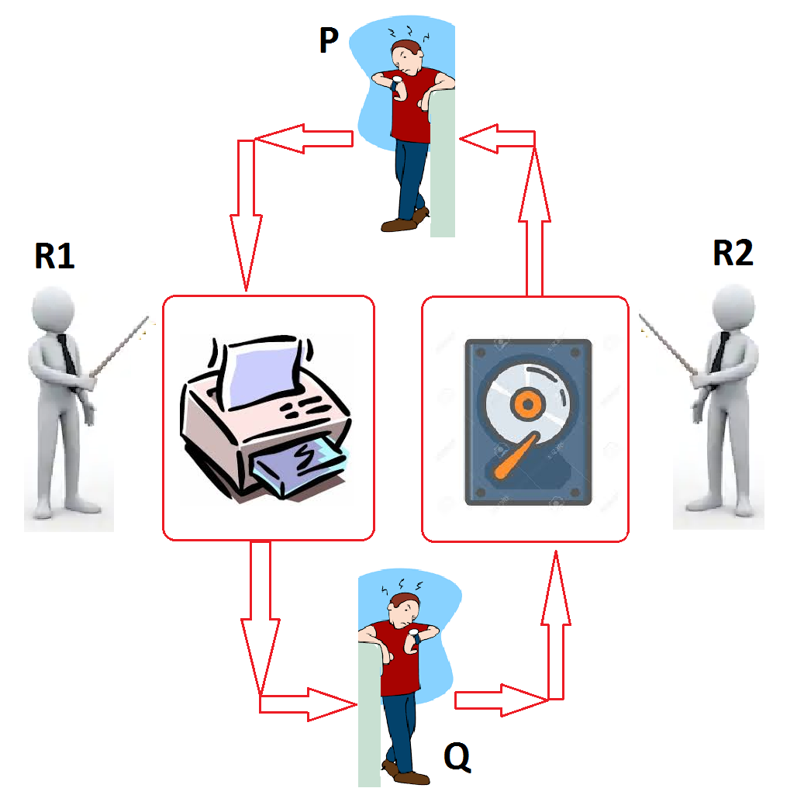

Slide 33
Discuss
Semaphore S1=1, S2=1
Process P
P(S1)
P(S2)
Run_critical_section_code()
V(S2)
V(S1)
Process Q
P(S2)
P(S1)
Run_critical_section_code()
V(S1)
V(S2)
It is likely to have a deadlock running the above example. Why we are not sure if a deadlock will happen or not?

Slide 34
Mutex and Deadlock
Deadlocks can happen with Mutex (or Lock) as well
A Mutex is a lock which can have one of the two states (locked/unlocked)
Only the process that locks a Mutex can open it.
A process trying to lock an already locked Mutex is blocked

Slide 35



Mutex and Deadlock
Assume Mutex M is used to enforce exclusive access to a resource
Process P locks Mutex M
Then P tries to lock it again.
But because M is already locked, P will wait until M is unlocked

Slide 36
Discuss
How long will process P wait? Why?
What solutions do you suggest?

Slide 37
Deadlock Avoidance
If any one of the four required deadlock conditions is violated, deadlock will not happen.
In practice we cannot change the type of resource.
The only condition that the resource manager can control is allocating in a way that circular hold-and-wait queues are not created.

Slide 38
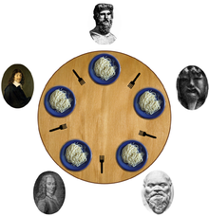
Dining Philosopher
Dining Philosophers is another classical problem which studies Deadlocks …
When can a deadlock happen?
Are you interested in implementing it? Then ...

Slide 39
Time to Apply
Week 5: Exercise B, C.

